Slide 1

STIX Introduction What is STIX and why is it relevant?

Slide 2
Objective: Setting the stage with some initial context on what STIX is and what is driving it

Slide 3


Diverse and Evolving Threats
Cyber defenders face a very capable and motivated set of adversaries
… and their number, sophistication and tempo of activity continue to increase.
The challenge is getting worse, not better.

Slide 4


Balance of Inward & Outward Focus
Traditional approach to security has been inward focused
Understand ourselves: find all vulnerabilities, fix all vulnerabilities, et voila we are magically “secure”
This is based on a fallacy that we can know and/or fix all vulnerabilities
Inward focus (hygiene) is necessary but inadequate.
Need for a balancing outward focus on understanding the adversary, their motivation, tactics, activity to make intelligent and realistic defense decisions.

Slide 5
Proactive & Reactive Actions Needed
Many attacks today are increasingly complex and multistage.
Current visibility and ability to act is typically after exploit has occurred
Response is important but inadequate alone
Need to balance response with proactive detection and prevention of pre-exploit activity
Kill Chain or Cyber Attack Lifecycle
Recon
Weaponize
Deliver
Exploit
Control
Execute
Maintain

Slide 6
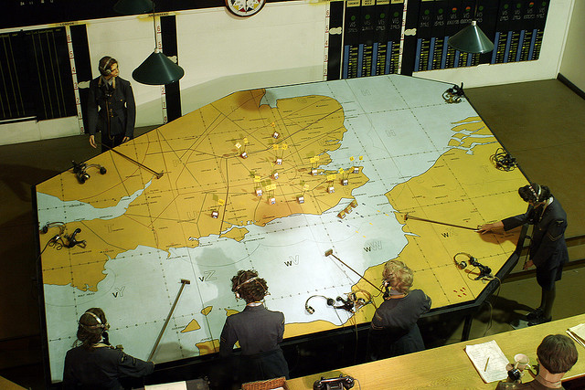
Need for Holistic Threat Intelligence
Effective understanding, decision-making and action require a holistic picture of both ourselves and the adversary.
What are our assets? What are our missions and activities? What is our attack surface? Where are we vulnerable?
Who is the adversary? Where are they acting? How are they acting? What does it look like when they act? What are they targeting? What actions should we take to mitigate their actions?
This is holistic threat intelligence

Slide 7
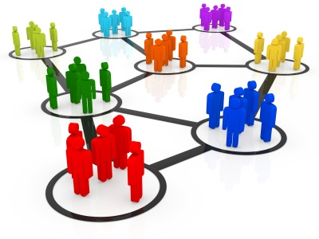
Need for Information Sharing
Holistic threat intelligence is not a single player sport
It depends on access to a wide range of information and no single entity, no matter how large, has the full picture to be consistently predictive or effective in prevention.
It requires sharing of information between interested parties.
Sharing applies both internally and externally
Sharing is not completely new but is typically focused on very atomic, limited-sophistication indicators (IP lists, file hashes, URLS, email addresses, etc.)
Most sharing is unstructured and human-to-human
There is a need to share more sophisticated behavioral and contextual information
How can my detection today aid your prevention tomorrow?

Slide 8
Cost to Adversary
Trivial/cheap to hop between IP addresses
Slightly more expensive to hop between domains
Difficult & expensive: Changing tactics and procedures to evade behavioral detection

Slide 9











Malicious Code enters and begins to attack vulnerable nodes
“Unaware” nodes are vulnerable to continued attacks
Network nodes of sharing communities...

Slide 10

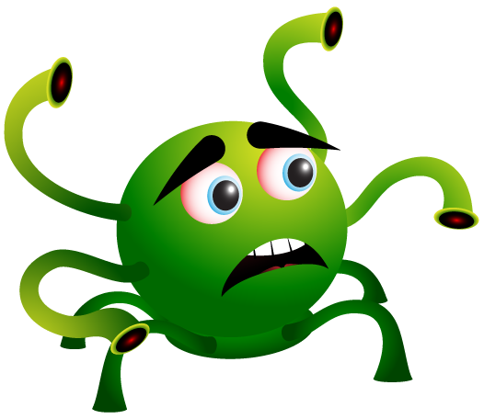
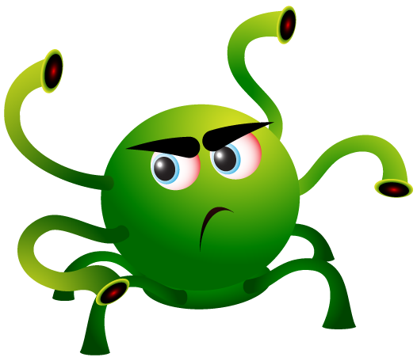



@#*%!
With the nodes now protected, the attack is thwarted
Malicious code enters again and attempts an attack
The first node hit shares information about the attack with other nodes
The chain of information continues until all nodes are safe from that attack
Remember those nodes?

Slide 11

Need for Automation
Massive amounts of information, diverse sharing partners, rapid tempo of attack and need to respond at machine speed require automation
Human interpretation and decision will always be involved but we need to assist them in this by letting machines do what machines do well.

Slide 12
Pulling it All Together
Pursuing holistic threat intelligence
Sharing of information among a diverse set of players
Leveraging automation throughout
Standardized Representation of Cyber Threat Information
STIX is intended to address this issue

Slide 13
What is STIX?
A language for the characterization and communication of cyber threat information
NOT a sharing program, database, or tool
…but supports all of those uses and more
Developed with open community feedback
Supports
Clear understandings of cyber threat information
Consistent expression of threat information
Automated processing based on collected intelligence
Advance the state of practice in threat analytics

Slide 14
Questions?

